Slide 1
Project 2
Guest Segmentation and Campaign Response Analysis
Presented by : Advithi D Kumpatla Hema Nageswari Devi T.Siva Keerthi Reddy Isukapalli Sravani K.Chandra Hasini Mentors : Ashish Rout Sohini Mitra

Slide 2
Problem Statement:
Guests are the driving force or the backbone of any retail company like Target. It is imperative to understand Guest purchasing behavior since most marketing strategies are designed around it. In this project we take a subset of guests and try to create guest segments and their response to campaigns. Here we have taken a subset of 2240 Target guests and related information over a 3 month period for various metrics like Demographic information ,Sales in multiple product categories, Response to campaigns etc.
Objectives:
Identify the best ways to segment guests for personalized marketing and discounts.
Analyze how each group responds to campaigns and predict future responses.

Slide 3
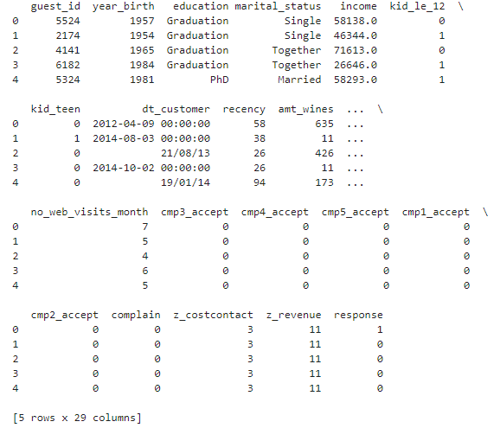
Dataset
The customer_segmentation_data contains 2240 rows and 29 columns, namely 'guest_id', 'year_birth', 'education', 'marital_status', 'income', 'kid_le_12', 'kid_teen', 'dt_customer', 'recency', 'amt_wines', 'amt_fruits', 'amt_bake', 'amt_deli', 'amt_sweets', 'amt_meats', 'no_deals', 'no_web', 'no_catalog', 'no_store', 'no_web_visits_month', 'cmp3_accept', 'cmp4_accept', 'cmp5_accept', 'cmp1_accept', 'cmp2_accept', 'complain', 'z_costcontact', 'z_revenue', and 'response’.

Slide 4
Data Preprocessing
Missing Values | The 24 missing values in the 'income' column were imputed using the median income, grouped by 'education' and 'age.'
Encoding Categorical Features | Ordinal encoding was used to transform ‘education’ and ‘marital_status’ to numerical format.
Removing Uninformative Features | Columns with one unique value, namely 'z_costcontact’ and 'z_revenue’ were dropped.
Derived Features | 'age’ feature by subtracting 'year_birth' from current year, ‘customer_year’ by using ‘dt_customer’, ‘total_spend’ by adding amount spent on all products, 'children' column by combining 'kid_teen' and 'kid_le_12’.
Dropping Utilized Features | ‘year_birth’ and ‘dt_customer’ are removed.

Slide 5
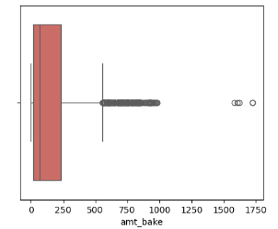
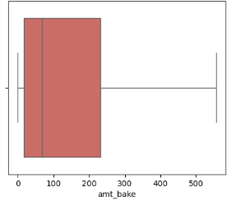
Handling Outliers
The figures above illustrate the graphs before and after using the interquartile range (IQR) method. This involves replacing outliers with thresholds of upper and lower bound to ensure data consistency and reliability.

Slide 6
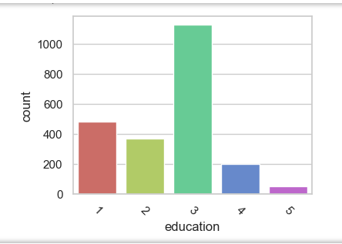
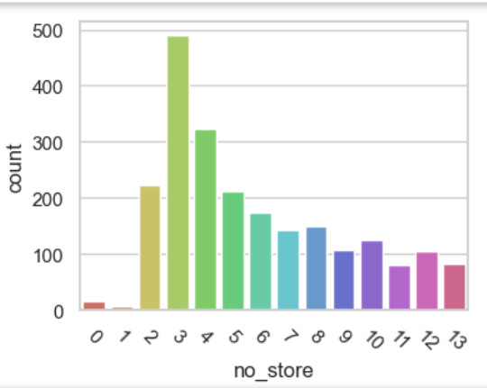
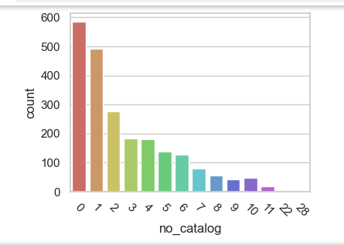
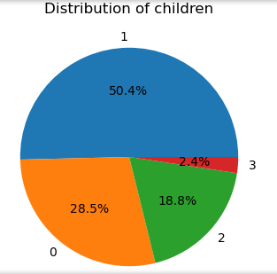
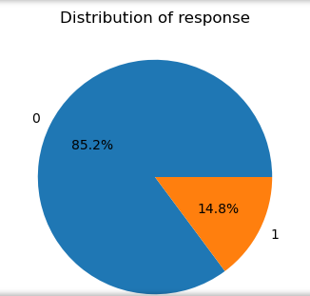
EDA
The above figures indicate the count plots and pie plots of education, number of visits to store, number of purchases through catalogs number of children and response variable.

Slide 7
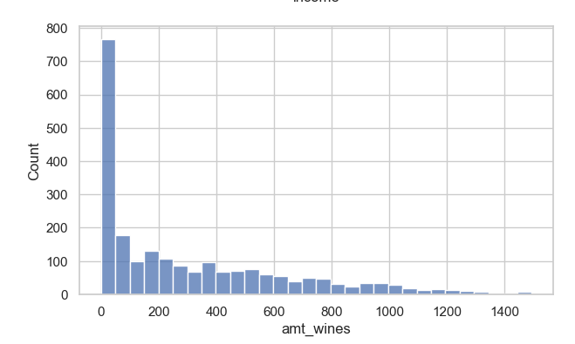
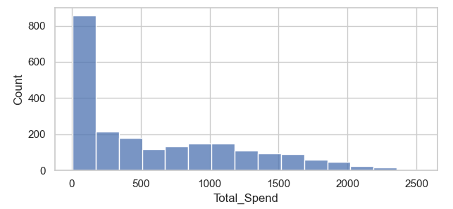
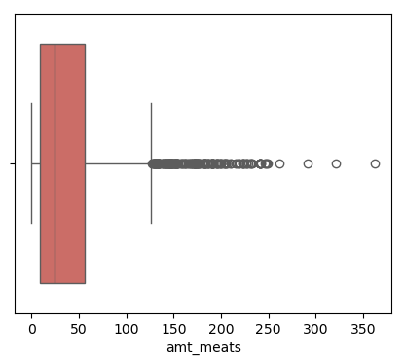
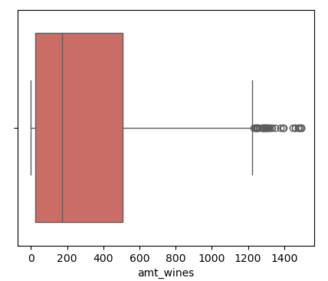
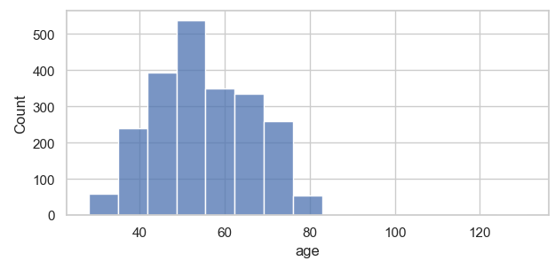
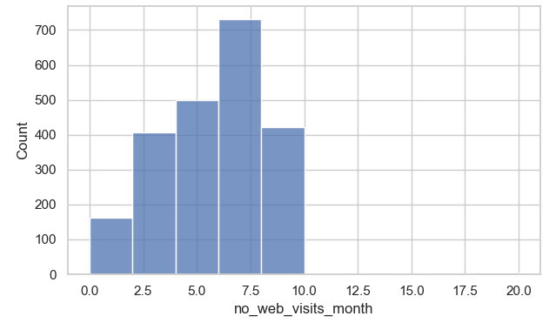
EDA
Above are the Hist plots and box plots of
amount on wines, total spend, age, number
of web visits per month and amount on meats.
Box plots for Outlier detection.

Slide 8
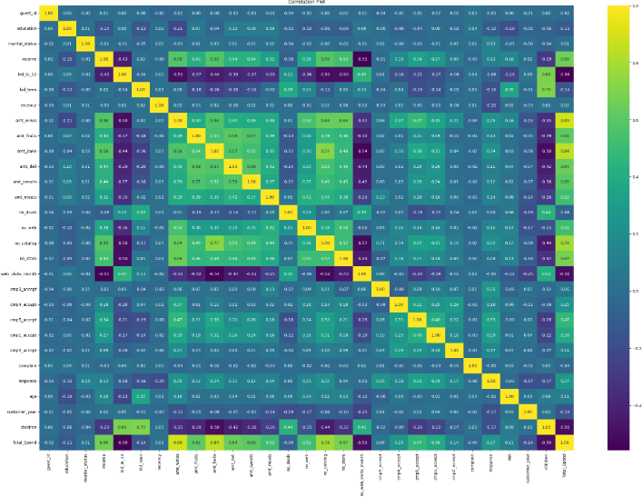
Correlation Matrix Analysis
Guests with higher incomes tend to spend more on wines, fruits, baked foods, and deli items.
Guests with young children generally exhibit lower spending on wines.
Higher-income individuals visit the website less but make more purchases, while lower-income individuals visit more but purchase less.
People with children visit websites more frequently and are more likely to purchase during deals and offers.

Slide 9
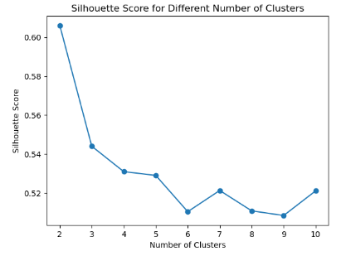
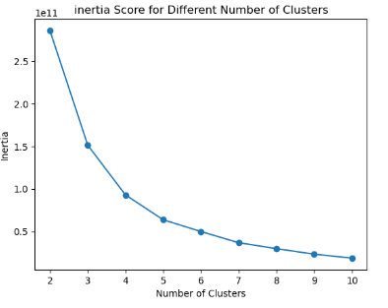
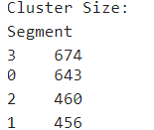
Clustering Techniques
The K-means algorithm uses Euclidean distance, to assign data points to the nearest cluster centroid. The figure below presents the silhouette curve, inertia curve, and cluster sizes, with Cluster 3 exhibiting a high number of guests.

Slide 10
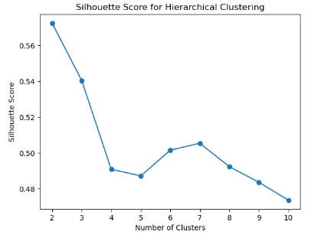
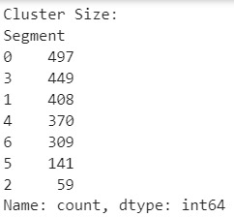
Clustering Techniques
Hierarchical clustering organizes data into a tree of clusters, using bottom-up or top-down approaches. The figure below presents the silhouette curve, and cluster sizes, with Cluster 0 containing the highest number of guests.

Slide 11
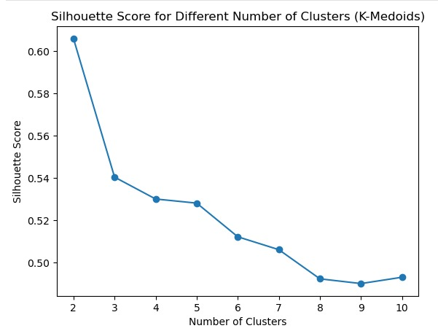
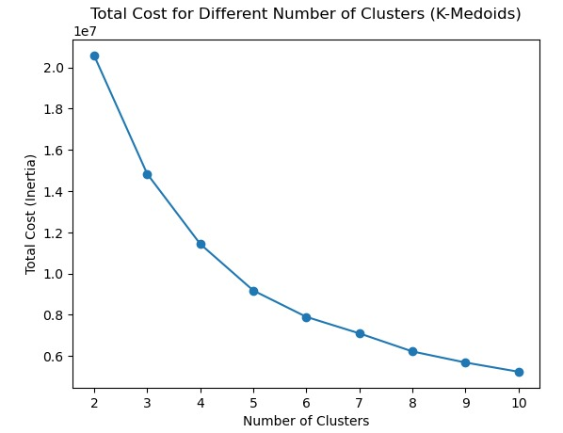
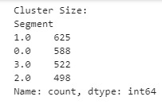
Clustering Techniques
K-medoids clustering forms clusters by selecting actual data points as cluster centers, minimizing the sum of dissimilarities between data points and their medoids. The figure below presents the silhouette curve, inertia curve, and cluster sizes, with Cluster 1 having a high number of guests.

Slide 12
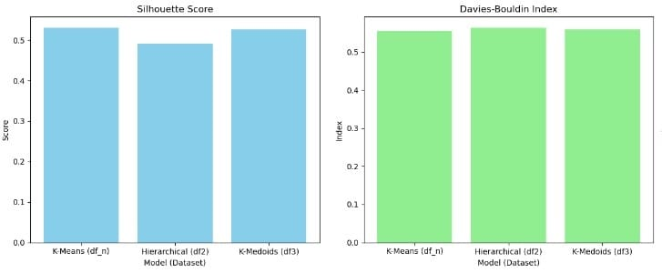
Comparative Analysis of Model Performance
K-means exhibits the best performace.
Hierarchical clustering shows lowest silhouette score and highest Davies-Bouldin index, reflecting its poor performance.
K-medoids performs better than hierarchical clustering although it does not surpass K-means.

Slide 13
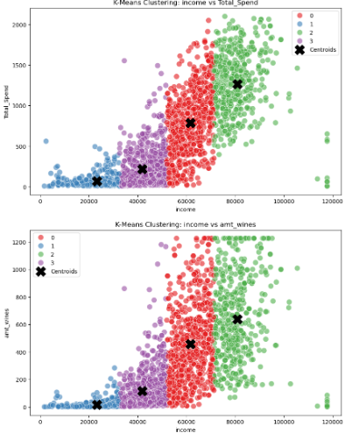
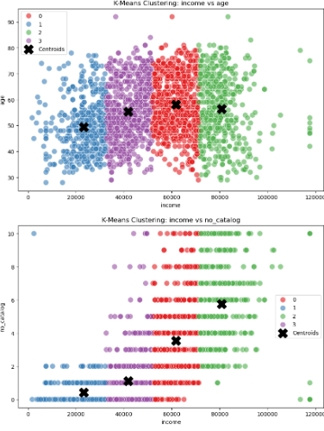
Interpretation of K-means Clustering

Slide 14
 | Cluster 0 | Cluster 1 | Cluster 2 | Cluster 3
Size | 643 | 456 | 460 | 674
Average age | 58.1 | 49.5 | 56.4 | 55.3
Education Level | Mostly Masters | Mostly Graduation | Mostly Graduation or Masters | Mostly Graduation or Masters
Marital Status | Together or Married | Together or Married | Mostly Married or Together | More Married or Together
Income | High | Low | Very High | Moderate
Web Visits | Moderate | High | Low | Moderate
Catalogs and Store Visits | Moderate | Low | Very High | Moderate
Complaint Rate | Low | Slightly Higher | Low | Slightly Higher
Response Rate | Moderate | Moderate | High | Moderate

Slide 15
Response Analysis
Cluster | Probability of response | Cluster Label
0 | 0.105754 | Premium Spenders
1 | 0.105263 | Web-Centric Thrifters
2 | 0.297826 | Wealthy Non-Digital Shoppers
3 | 0.115727 | Stable Shoppers
The table illustrate the probability of response for each cluster, as determined by the
K-Means clustering algorithm.

Slide 16
Thank You

Slide 17
Cluster Label Summary
Cluster 0 : Premium Spenders
This cluster represents high-income individuals who spend significantly on various product categories and have moderate engagement .
Cluster 1 : Web-Centric Thrifters
Low-income and high web engagement but spend less on products. They are younger and have a higher number of kids under 12.
Cluster 2 : Wealthy Non-Digital Shoppers
This cluster includes very high-income individuals who spend extensively across multiple categories but engage less with online platforms.
Cluster 3 : Stable Shoppers
Moderate-income with balanced expenditure across various categories, showing moderate engagement both online and offline

Slide 18
Evaluation metrics
The Silhouette Score
Measures how well clusters are defined in a clustering algorithm. It evaluates how similar an object is to its own cluster compared to other clusters. The score ranges from -1 to 1, where a higher score indicates better clusters. For each point, the Silhouette Score calculates cohension and separation.
The Davies-Bouldin Index (DBI)
Is a metric used to evaluate the quality of clustering by measuring the average similarity ratio of each cluster with its most similar cluster. A lower DBI indicates better clustering. It compares intra-cluster distance to distance from other clusters (inter-cluster). It calculates the worst-case ratio between clusters and averages them. A lower DBI indicates more compact and well-separated clusters.

Slide 19
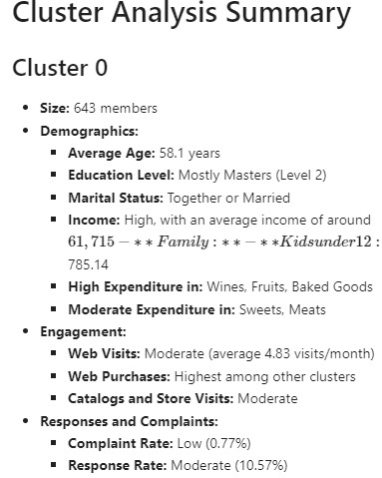
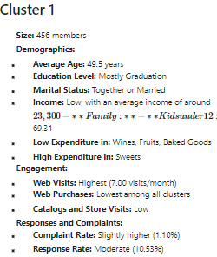

Slide 20
